Slide 1
Continuous probability distributions
Normal Distribution, joint probability distribution,

Slide 2
Continuous probability distributions
A continuous probability distribution is the probability distribution of a continuous variable.
A continuous variable can have any value between its lowest and highest values. Therefore, continuous probability distributions include every number in the variable’s range.
The probability that a continuous variable will have any specific value is so infinitesimally small that it’s considered to have a probability of zero. However, the probability that a value will fall within a certain interval of values within its range is greater than zero.

Slide 3
What is a Normal Distribution?
The normal distribution is the most significant probability distribution in statistics as it is suitable for various natural phenomena such as heights, measurement of errors, blood pressure, and IQ scores follow the normal distribution.
The other names for the normal distribution are Gaussian distribution and the bell curve.
The normal distribution is a probability distribution that outlines how the values of a variable are distributed. Most of the observations clusters around the central peak and probabilities for values far away from mean fall off equally in both the directions in a normal distribution. Extreme values in both the tails of the distribution are uniformly unexpected.
The spread of the normal distribution is managed by the standard deviation . The smaller the standard deviation value in a normal distribution formula, the more concentrated the data

Slide 4
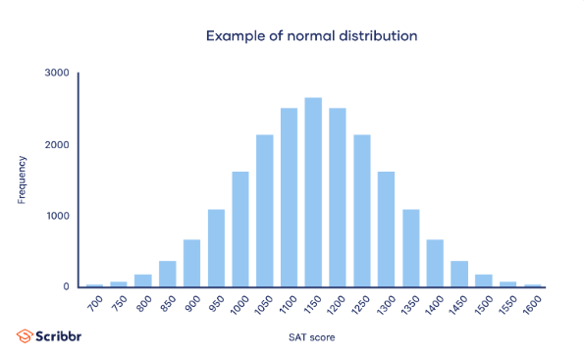
Example

Slide 5
Why do normal distributions matter?
All kinds of variables in natural and social sciences are normally or approximately normally distributed. Height, birth weight, reading ability, job satisfaction, or SAT scores are just a few examples of such variables.
Because normally distributed variables are so common, many statistical tests are designed for normally distributed populations.
Understanding the properties of normal distributions means you can use inferential statistics to compare different groups and make estimates about populations using samples.

Slide 6
What are the properties of normal distributions?
Normal distributions have key characteristics that are easy to spot in graphs:
The mean, median and mode are exactly the same.
The distribution is symmetric about the mean—half the values fall below the mean and half above the mean.
The distribution can be described by two values: the mean and the standard deviation.

Slide 7
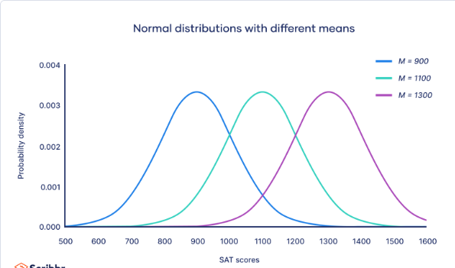
What are the properties of normal distributions?
The mean is the location parameter while the standard deviation is the scale parameter.
The mean determines where the peak of the curve is centered. Increasing the mean moves the curve right, while decreasing it moves the curve left.

Slide 8
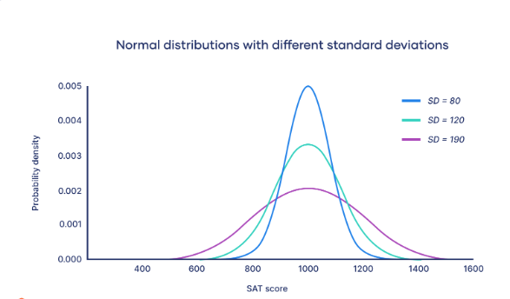
What are the properties of normal distributions?
The standard deviation stretches or squeezes the curve. A small standard deviation results in a narrow curve, while a large standard deviation leads to a wide curve.

Slide 9
Empirical rule
The empirical rule, or the 68-95-99.7 rule, tells you where most of your values lie in a normal distribution:
Around 68% of values are within 1 standard deviation from the mean.
Around 95% of values are within 2 standard deviations from the mean.
Around 99.7% of values are within 3 standard deviations from the mean
The empirical rule is a quick way to get an overview of your data and check for any outliers or extreme values that don’t follow this pattern.
If data from small samples do not closely follow this pattern, then other distributions like the t-distribution may be more appropriate. Once you identify the distribution of your variable, you can apply appropriate statistical tests.

Slide 10
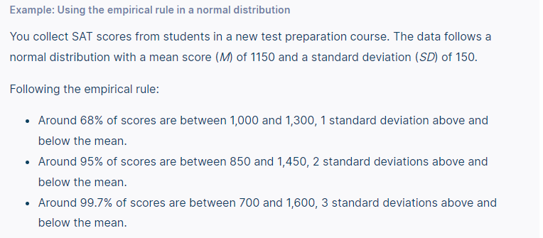

Slide 11
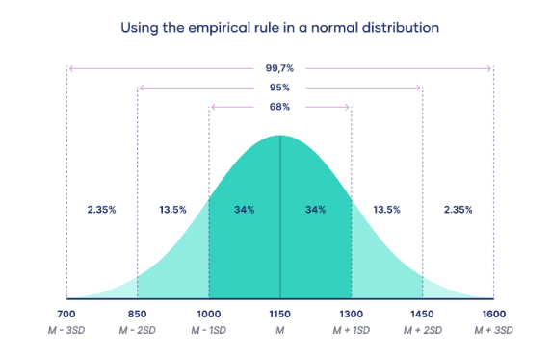

Slide 12
Central limit theorem
The central limit theorem is the basis for how normal distributions work in statistics.
In research, to get a good idea of a population mean, ideally you’d collect data from multiple random samples within the population. A sampling distribution of the mean is the distribution of the means of these different samples.
The central limit theorem shows the following:
Law of Large Numbers: As you increase sample size (or the number of samples), then the sample mean will approach the population mean.
With multiple large samples, the sampling distribution of the mean is normally distributed, even if your original variable is not normally distributed.

Slide 13
Central limit theorem
Parametric statistical tests typically assume that samples come from normally distributed populations, but the central limit theorem means that this assumption isn’t necessary to meet when you have a large enough sample.
You can use parametric tests for large samples from populations with any kind of distribution as long as other important assumptions are met. A sample size of 30 or more is generally considered large.
For small samples, the assumption of normality is important because the sampling distribution of the mean isn’t known. For accurate results, you have to be sure that the population is normally distributed before you can use parametric tests with small samples.

Slide 14
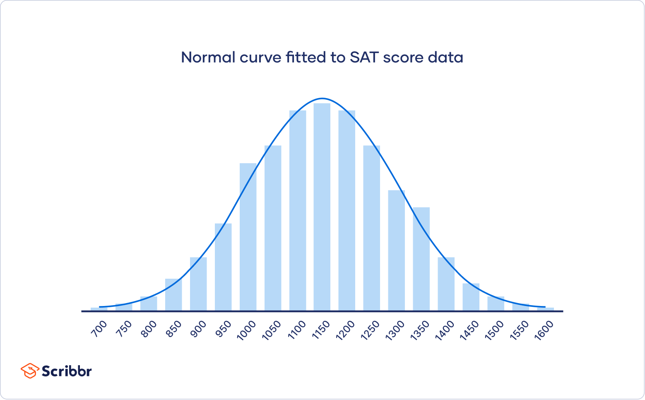
Formula of the normal curve
Once you have the mean and standard deviation of a normal distribution, you can fit a normal curve to your data using a probability density function.

Slide 15
Formula of the normal curve
In a probability density function, the area under the curve tells you probability. The normal distribution is a probability distribution, so the total area under the curve is always 1 or 100%.
The formula for the normal probability density function looks fairly complicated. But to use it, you only need to know the population mean and standard deviation.
For any value of x, you can plug in the mean and standard deviation into the formula to find the probability density of the variable taking on that value of x.

Slide 16
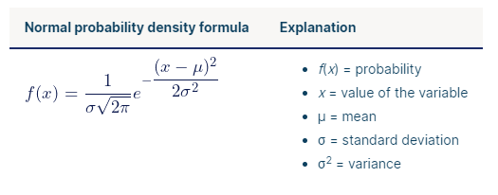
Formula of the normal curve

Slide 17
Formula of the normal curve

Slide 18
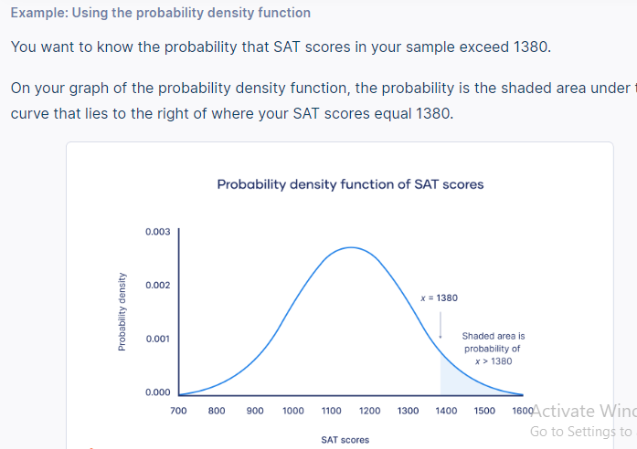
Formula of the normal curve
You can find the probability value of this score using the standard normal distribution.

Slide 19
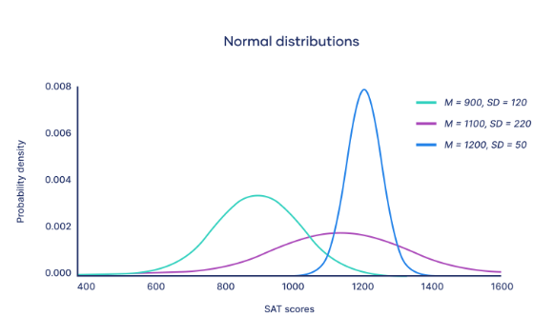
What is the standard normal distribution?
The standard normal distribution, also called the z-distribution, is a special normal distribution where the mean is 0 and the standard deviation is 1.
Every normal distribution is a version of the standard normal distribution that’s been stretched or squeezed and moved horizontally right or left.

Slide 20
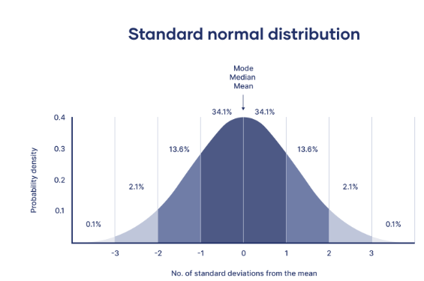
What is the standard normal distribution?
While individual observations from normal distributions are referred to as x, they are referred to as z in the z-distribution. Every normal distribution can be converted to the standard normal distribution by turning the individual values into z-scores.
Z-scores tell you how many standard deviations away from the mean each value lies.

Slide 21
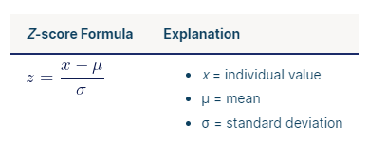
What is the standard normal distribution?
You only need to know the mean and standard deviation of your distribution to find the z-score of a value.
We convert normal distributions into the standard normal distribution for several reasons:
To find the probability of observations in a distribution falling above or below a given value.
To find the probability that a sample mean significantly differs from a known population mean.
To compare scores on different distributions with different means and standard deviations.

Slide 22
Finding probability using the z-distribution
Each z-score is associated with a probability, or p-value, that tells you the likelihood of values below that z-score occurring. If you convert an individual value into a z-score, you can then find the probability of all values up to that value occurring in a normal distribution.

Slide 23
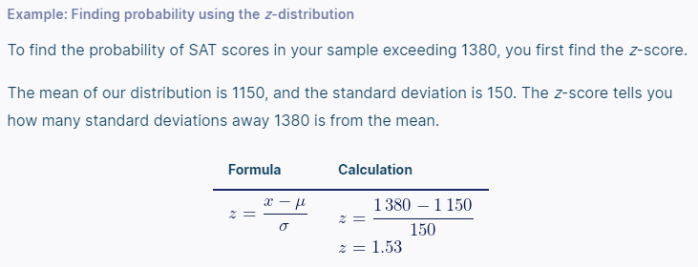
Finding probability using the z-distribution

Slide 24
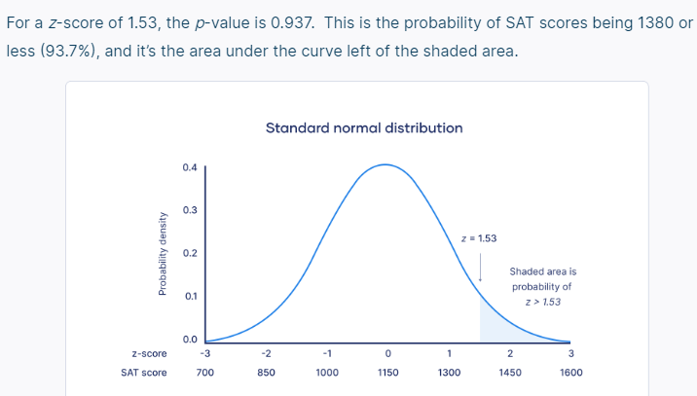
Finding probability using the z-distribution
To find the shaded area, you take away 0.937 from 1, which is the total area under the curve.
Probability of x > 1380 = 1 – 0.937 = 0.063
That means it is likely that only 6.3% of SAT scores in your sample exceed 1380.

Slide 25
Joint Probability
Probability is a branch of mathematics which deals with the occurrence of a random event. In simple words it is the likelihood of a certain event. A statistical measure that calculates the likelihood of two events occurring together and at the same point in time is called Joint probability.
Let A and B be the two events, joint probability is the probability of event B occurring at the same time that event A occurs.
Notation to represent the joint probability can take a few different forms.

Slide 26
Joint Probability
The following formula represents the joint probability of events with intersection.
P (A⋂B)
where,
A, B= Two events
P(A and B),P(AB)=The joint probability of A and B
The symbol “∩” in a joint probability is called an intersection.
The probability of event A and event B happening is the same thing as the point where A and B intersect.
Hence, the joint probability is also called the intersection of two or more events.

Slide 27
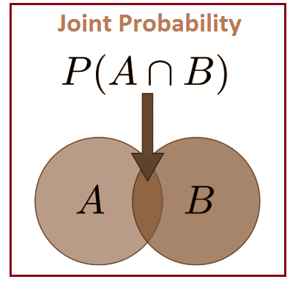
Joint Probability

Slide 28
Joint Probability Distribution
Let A, B, …., be the random variables which are defined on a probability space. The probability distribution that gives the probability that each of A, B, …. falls in any particular range or discrete set of values specified for that variable is defined as the joint probability distribution for A, B, ….. In the case of only two random variables, this is called a bivariate distribution, otherwise, it is a multivariate distribution.
The joint probability distribution can be expressed in different ways based on the nature of the variable. In case of discrete variables, we can represent a joint probability mass function. For continuous variables, it can be represented as a joint cumulative distribution function or in terms of a joint probability density function.

Slide 29
Joint Probability Examples
Example: Find the probability that the number three will occur twice when two dice are rolled at the same time.
Solution:
Number of possible outcomes when a die is rolled = 6 i.e. {1, 2, 3, 4, 5, 6}
Let A be the event of occurring 3 on first die and
B be the event of occurring 3 on the second die.
Both the dice have six possible outcomes, the probability of a three occurring on each die is 1/6.
P(A) =1/6
P(B )=1/6
P(A,B) = 1/6 x 1/6 = 1/36

Slide 30
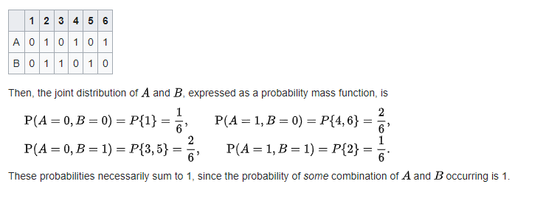
Example
Consider the roll of a fair die and let A=1 if the number is even (i.e. 2, 4, or 6) and A=0 otherwise. Furthermore, let B=1 if the number is prime (i.e. 2, 3, or 5) and B=0 otherwise.

Slide 31
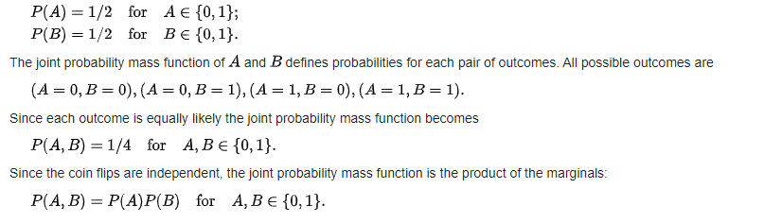
Example
Consider the flip of two fair coins; let A and B be discrete random variables associated with the outcomes of the first and second coin flips respectively. If a coin displays "heads" then the associated random variable takes the value 1, and it takes the value 0 otherwise. The probability of each of these outcomes is 1/2, then

Slide 32
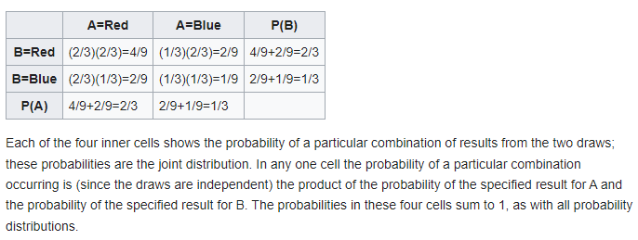
Example
Each of two urns contains twice as many red balls as blue balls, and no others, and one ball is randomly selected from each urn, with the two draws independent of each other. Let A and B be discrete random variables associated with the outcomes of the draw from the first urn and second urn respectively. The probability of drawing a red ball from either of the urns is 2/3, and the probability of drawing a blue ball is 1/3. The joint probability distribution is presented in the following table

